Slide 1



Smartphones: the new
frontier in parenting
PARENT PRESENTATION 2025
Notes:
Smartphone Free Childhood has spread rapidly across the UK this year and this presentation highlights some of the issues around smartphones and children, and how we can work together to improve the situation for our children. Smartphones and children have become a big talking point recently because this is an issue that every family in Britain today has to contend with. There’s very little advice out there on this issue, and many of us aren’t sure what approach to take. No previous generation of parents or young people have had to deal with this like we do.

Slide 2







In two decades, everything’s changed
2004
2024
2004
2007
2008
2012
2024
4G launches in
the UK, enabling internet everywhere
89% of 12-year-olds own a smartphone, permanently connected to the internet via 4g/5g
Nokia’s ruled
The first
iPhone launches
Apple app store opens
Notes:
Less than two decades ago, smartphones were a mere twinkle in Steve Jobs’ eye. The speed of this technological and sociological change has been unprecedented and it’s affected everything, including childhood. Even in the last five years the speed of change has accelerated dramatically - just a few years ago we were used to having to go into a cafe to get a Wifi signal because data was slow and expensive. Now all of us expect to be connected to everything, everywhere at all times via superfast 4G & 5G connections.

Slide 3

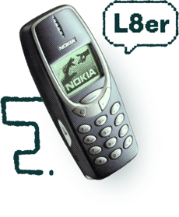
They’re not really ‘phones’ at all
Mobile Phones
Pocket Supercomputer
Make calls, send texts, play Snake
24/7 access to the internet in your pocket
Notes:
We call them ‘phones’, but it’s a pretty misleading name. It would be more accurate to call them handheld supercomputers – that put the whole of the internet and social media in your pocket 24/7. It’s important to point out that they don’t just give our children access to the internet – they give the whole of the internet access to our children.

Slide 4


Parents wish things were different
94%
70%
33%
of primary school parents think smartphones
are harmful
of parents believe smartphones negatives impact family life
of parents of children with smartphones have cried over their child’s phone obsession
Parentkind nationwide poll of 2,496 people, April 24
HMD poll of 10,000 parents, June 24
HMD poll of 10,000 parents, June 24
Notes:
Despite their ubiquitous presence in modern life, most parents are aware of the fact that smartphones are harmful for kids and that they can negatively impact family life. A recent poll of 10,000 parents found that a third of parents have cried over their child’s phone obsession - and half of them believe that smartphones changed their child’s personality.

Slide 5

Young people wish things were different
67%
1in5
50%
of 16-18 year olds think smartphones are harmful
of 16-18 year olds have felt “life is not worth living” due to social media
of teens say they are “addicted” to social media
Parentkind poll, 2024
Parentkind poll, 2024
Millennium Cohort Study, 2024
Notes:
Young people themselves are far more self aware about the issue of smartphones than we sometimes give them credit for. Two thirds of teens think that smartphones are harmful, a fifth say that social media has made them feel like ‘life is not worth living’, and half believe they are addicted. The same Parentkind poll found that 68% of teens think that tech companies should do more to protect them from harmful content.

Slide 6




Yet smartphones have become the norm
25%
89%
of 5-7 year olds in the UK own their own smartphone
of 12 year-olds in the UK own their own smartphone
SOURCE: OFCOM Children and Parents: Media Use and Attitudes April 24
Notes:
Despite the fact that we are all aware of the harms they are causing, smartphones have become the norm. A quarter of 5-7 year olds in the UK own one - and by the age of 12, just 11% of kids are smartphone-free. Another shocking Ofcom stat that we didn’t have space to include on here is that a fifth of 3 and 4 year olds owns a smartphone in the UK. And every year the age of first smartphone-ownership is getting younger.

Slide 7


Everyone’s got one, because
everyone’s got one!
The powerful network effects of smartphones and social media mean parents and young people feel like they have no choice
Most parents believe smartphones are harmful, yet almost all children have them by Year 7
Because resisting peer pressure becomes almost impossible when children’s social lives migrate online
Notes:
So if we all know that smartphones aren’t necessarily a good thing for children, why does almost every child have a smartphone? Because everyone else has. Resisting the peer pressure to get a smartphone is almost impossible if every other child in your child’s class has one. No parent wants their child to be left out and isolated from their peer group. The powerful network effect of these devices means that many parents and young people feel like they have absolutely no choice in the matter.

Slide 8



So what exactly
is the problem?
Notes:
Let’s dig in to some of the specific issues with smartphones and children

Slide 9

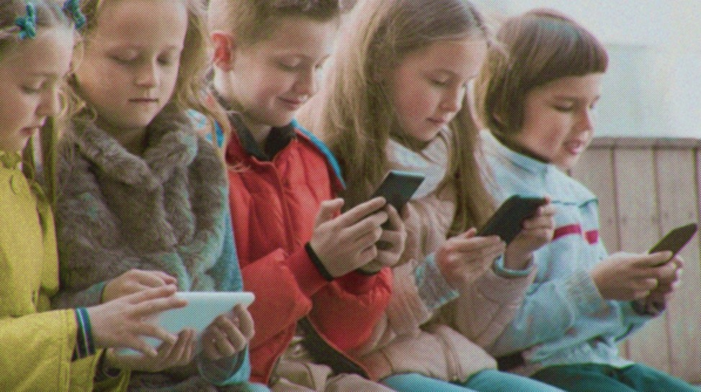

When children first started getting smartphones in the early 2010s we didn’t understand their impact.
Now we do, and the evidence is overwhelming.
Notes:
Smartphones have been with us for barely 15 years, and we’re only now beginning to see the impact of these devices on a generation of children.

Slide 10
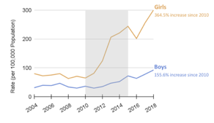
Smartphones are fuelling a mental health crisis
Rates of depression, anxiety, self-harm and even suicide among teens have all dramatically spiked globally since 2010 – when children started getting smartphones.
A 2023 global study of 27,969 young adults from Sapiens Labs showed that the younger they got their first smartphone, the worse their mental health today.
67%
Teens with problematic smartphone-use are twice as likely to have anxiety and three times as likely to have depression
King's College London, 2024
UK Teens, self-harm Episodes (Ages 10-12)
1in5
UK 16 to 18 years olds say that their social media has made them feel that ‘life is not worth living’
Royal College of Psychiatrists, 2024
53%
The number of children referred to emergency mental healthcare in England has soared by 53% in three years
Parentkind Poll, 2024
Notes:
Since 2010, when children first started getting smartphones, rates of anxiety, depression and self harm have all spiked dramatically across the globe. Some academics debate whether smartphones and social media have caused this mental health crisis or are just correlated with it, but even so the correlation is stark and no alternative explanations stack up. More and more research points to the conclusion that too much time spent on these devices can be very harmful to children’s mental health in the short and long-term.

Slide 11


“The mental health crisis among young people is an emergency.
It is time to require a warning
label on social media platforms.”
Dr Vivek Murthy
US Surgeon General, 2024
Notes:
This year, America’s most senior doctor – whose job it is to provide the nation with the best scientific information on how to improve their health – called on the government to impose smoking-style warning labels on social media. He wants people who visit these platforms to be shown a message warning that they are "associated with significant mental health harms for adolescents". He said such a label would "regularly remind parents and adolescents that social media has not been proved safe".

Slide 12

Smartphones expose children to harmful content
Having unrestricted access to the internet in your pocket creates a gateway to extreme content and viewpoints that we’d never dream of exposing children to in real life.
Hardcore pornography, extreme political views, sexualised and violent imagery, trolling and material promoting suicide, self-harm and eating disorders have become part of the fabric of modern childhood.
51%
of UK 11-13 year-olds have seen hardcore pornography online
British Board of Film Classification Report, March 2022
The dangers of platforms like TikTok
75%
of UK 15 year olds questioned had been sent beheading videos
Digital Childhoods, children’s commissioner report, 2022
90%
of girls and 50% of boys say they are sent unwanted explicit content
Ofsted review of sexual abuse in schools, 2021
Notes:
Smartphones are a gateway to extreme content and viewpoints, from hardcore pornography to sexualised and violent imagery, and videos promoting self harm, suicide and anorexia. Even if children don’t search this content out, they will be served it by the algorithm on social media, and sent it via their friends on WhatsApp. Once they’ve seen these things, they can’t unsee them. Being immersed in this sort of toxic content has the effect of normalising it over time for your child. New research by UCL published in Feb 2024 found that social media algorithms amplify extreme content, such as misogynistic posts, which is normalising harmful ideologies for young people.

Slide 13

“We’ll look back in 20 years and be horrified by what our children were exposed to”
Dame Rachel de Souza
Children’s Commissioner for England, 2022

Slide 14

Smartphones are addictive by design
Tech companies spend billions on making apps and devices as addictive as possible because ‘maximising engagement’ is the fundamental objective of their business model.
So it’s little wonder that many children are routinely ‘spending six, seven, eight hours a day on social media – often more’ (Ofcom, 2024).
46%
of teens say they use the their phones “almost constantly”
Pew Research Centre, Aug 2022
Time spent on phones is only going up
29hrs
Per week is the average British 12-year-old now spends on their smartphone
Childwise Monitor Report, 2021
2in3
of 11-17 year olds ‘often’ or ‘sometimes’ find it difficult to put down their phone
Common Sense Media, 2023
Notes:
The business model of the social media companies is simple. The more time we spend on their apps, the more data they can harvest about us, the more targeted the adverts they can sell and the more money they make. This is why they spend billions on ‘maximising engagement’, using teams of computer engineers and behavioural scientists to ensure that their platforms are as addictive as possible. Things like infinite scroll, Snapstreaks, likes and comments all trigger our brain’s dopamine circuits in a similar way to that of slot machine gambling. Children’s brains, which are not yet fully developed, are particularly vulnerable to this – it’s no wonder that Ofcom reports that many children are routinely spending eight hours a day on social media. One Harvard study found that social media platforms made nearly $11 billion in advertising revenue off kids and teens in 2022.

Slide 15

“Behind every screen on your phone, a thousand engineers have worked to make it maximally addicting. Children are particularly susceptible to this kind of manipulative design.”
Aza Raskin
Co-inventor of ‘infinite scroll’, turned campaigner

Slide 16
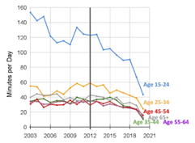
Smartphones are changing childhood
Smartphones are experience blockers, distracting children from engaging in the real world activities and connections that are crucial to healthy childhood development.
The opportunity cost to childhood is profound. The average UK 12 year-old now spends over four hours per day on their smartphone, displacing the kinds of activities that have shaped childhood for millennia.
43%
of US teenagers waking minutes are spent on screens
Gitnux Marketdata Report, Jan 2024
30%
Since 1975, the daily average time children spend playing outdoors has fallen by 30%, while screen-based activities have risen 23%
Daily Avg Time with Friends (minutes)
Zach Rausch - Mullan 2019
65%
The daily average time that teenagers spend with friends has plummeted by 65% since 2010
American Time Use Study
Notes:
Beyond the harms we’ve already mentioned, perhaps the most serious and overlooked of all of them is the opportunity cost – all the things that children are not doing when they’re spending hours per day on smartphones. Childhood is short, and time is the most precious resource any of us have. In the UK, the average 12-year-old now spends 4 hours per day on their phone. This is time when they could be hanging out with their family and friends, playing, reading, kicking a ball – vital real world activities and relationships that enable kids to learn the life skills they need to transition into adulthood. None of these kids will look back fondly on the childhood memories they made scrolling Snapchat!

Slide 17

“When kids are on their phones all day, it’s not just what they're doing on the phone that matters — it’s what they’re not doing. They’re missing out on crucial experiences that help them grow into healthy adults.”
Dr Jonathan Haidt
Professor of Social Psychology, NYU

Slide 18

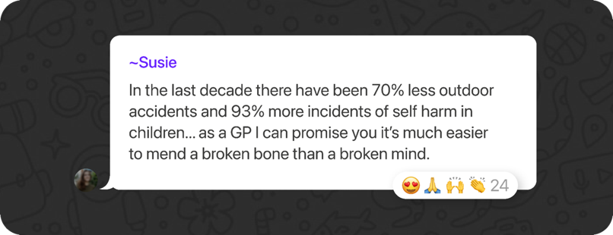
Dr Susie Davies, founder of Papaya Parents, citing NHS DATA
Notes:
Dr Susie Davies, a GP in Bristol and a parent in the Smartphone Free Childhood WhatsApp groups, posted this message citing NHS data earlier this year

Slide 19






Sadly, we could go on
SLEEP
BULLYING
DISTRACTIONS
Bedtime use of smartphones doubles children's risk of poor sleep
On average teens are bombarded by 237 smartphone notifications a day
84% of bullying now takes place on a device
Jama Paediatrics, 2016
CommonSense Media, 2023
LookUp
ARGUMENTS
ROAD SAFETY
CRIME
55% of parents say their child’s smartphone use causes big family arguments
Mobile phone distraction is a major cause of road accidents involving children
500 children a day were mugged in 2020 in the UK, almost all for smartphones
Ofcom, 2022
HMD, 2024
ONS, 2020
Notes:
There are so many other harms to mention, but if we look at them all in detail we could be here all day. Suffice to say that from sleep to bullying to road accidents, smartphones negatively impact children’s lives in a wide variety of ways.

Slide 20

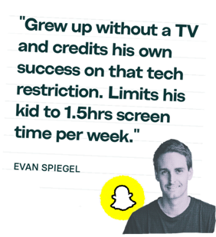
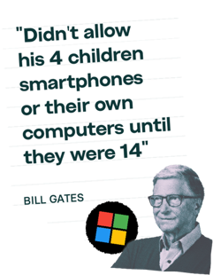
It’s little wonder that many of the people who created this technology keep it away from their kids
Notes:
Many of the Big Tech moguls don’t allow their own children to use these devices – they know full well how addictive and harmful the products they created can be to kids

Slide 21

Parents are in an impossible position
Notes:
The fact is, that parents today are in an impossible position because of the rapid proliferation and technological advances of smartphones and social media

Slide 22


Because our ‘choice’ isn’t really a choice at all
Either we…
Or we…
Give our children access to a product that we know to be harmful.
Risk alienating them from their peers at a crucial stage of their development.
It’s a lose-lose; for parents for children & for society
Notes:
Either we give our children access to an adult product that we know to be harmful, or we risk cutting them off from their peers just at the moment when we want them to make new friends at a crucial stage of their lives.

Slide 23
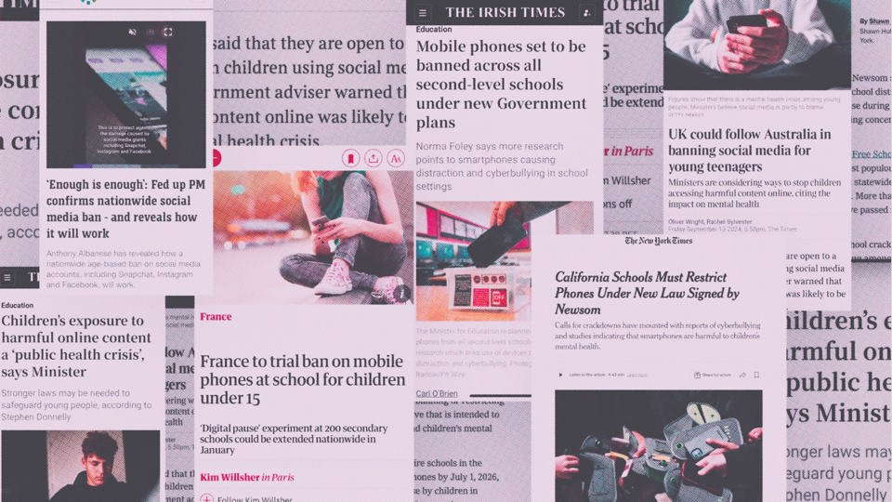

Leaders across the world are thinking about how to legislate to protect children
Leaders across the world are thinking about how to legislate to protect children
Notes:
From France to Australia, Ireland to America, governments across the world are beginning to recognise the problem and think about how we can protect childhood This is encouraging, but…

Slide 24
Leaders across the world are thinking about how to legislate to protect children
Leaders across the world are thinking about how to legislate to protect children
But proper regulation of big tech will take years, and we don’t have time to waste
Notes:
Unfortunately, our children could well be adults by the time smartphones and the internet are truly safe spaces for children – we simply don’t have time to sit around and wait

Slide 25


The solution is to work together
Notes:
Thankfully, the power to protect our children right now, is in our hands

Slide 26


If we all agree to delay giving our children smartphones, and instead gave them brick phones until at least the end of Year 9,
the peer pressure instantly reduces.
Saying no can feel impossible when
you’re acting alone. Acting collectively
makes it infinitely easier.
Notes:
The key to solving this problem is each other - every one of us in. If we all agree to wait to get our children smartphones together, the pressure instantly dissolves. Doing this alone can feel impossible when the peer pressure is so intense - but if we do it together, and your child knows that there are others in their class not getting a smartphone too, then they are happy to wait.

Slide 27


This is what Smartphone Free Childhood is all about.
It’s a growing movement of 150,000 parents in the UK who are coming together to support each other in delaying access to smartphones and social media for their children.
It’s coordinated via a national network of WhatsApp communities where parents can learn more about the issue, find other like-minded parents and support one another.
Notes:
Smartphone Free Childhood is a growing movement of 150,000 parents across the country who are coming together to wait to get their children smartphones. There’s a Smartphone Free Childhood WhatsApp community in every county in Britain, where parents can find support and advice about how to protect their children from the risks of smartphones and social media.

Slide 28
We’re not anti-tech,
We’re pro childhood
Technology has immense benefits, and young people should be able to enjoy the opportunities it creates – when they’re ready and when it’s safe to do so.
But childhood is precious and fleeting. All children should have the opportunity to learn, develop and grow free from the addictive-by-design algorithms and age-inappropriate content of social media and smartphones.
Notes:
We are aware that technology has huge benefits for all of us and creates amazing opportunities – children should be about to benefit from them when the time is right and where the products re safe. But we also know that childhood is precious and fleeting – and we believe that all children should be allowed to grow up free from the addictive-by-design algorithms and inappropriate content of these devices.

Slide 29






Our recommended approach
01
02
03
04
Delay smartphones until at least 14
Delay social media until at least 16
A simple phone to stay in contact
Shared access to a family computer
FAMILY COMPUTER
SMARTPHONE
SOCIAL MEDIA
SIMPLE PHONE
Notes:
We recommend that parents get their child a simple phone instead of a smartphone until the end of Year 9 at the earliest. That means you can keep in touch when they’re out and about using calls and texts, without any of the harms associated with smartphones and social media. When they want to use the internet, they can do so on a shared family computer, which could even have WhatsApp on it if you feel comfortable with that. This way they can get acquainted with the digital world and stay connected to their friends without the temptation of having it in their pocket 24/7.

Slide 30
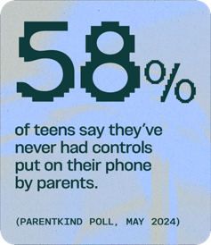
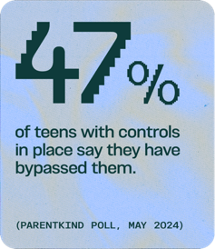
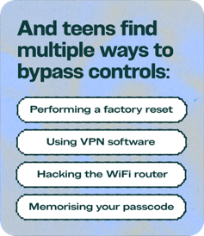
Parental controls aren’t the solution
Even the most tech-savvy parents struggle to manage parental controls
Some apps require updates to hundreds of settings to make them age appropriate
Even if your child’s phone has controls, their friends may not so they may be sent harmful content regardless
Notes:
Tech companies currently put all the responsibility on parents shoulders to keep their kids safe online, saying parents just need to use parental controls. Unfortunately, these are not watertight and even the most tech savvy of parents can be thwarted by the complicated set up. The majority of children have never had controls put on their phone by parents - and nearly half of those who have have bypassed them. Ultimately we believe that the tech companies should have mandatory and universal safe set up of devices so that the responsibility does not fall on parents - and those children whose parents don’t have the time or tech knowledge to do it, aren’t exposed to harm.

Slide 31



makes collective action simple
Notes:
Introducing the Parent Pact - the Smartphone Free Childhood solution to empower parents to come together to keep our children safe

Slide 32

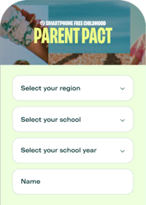

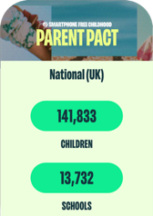
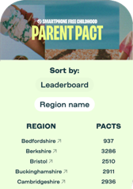
The Parent Pact is an online tool that helps parents agree to delay with others in your community. The more of us who sign, the more powerful it becomes.
STEP 01
STEP 02
STEP 03
Select your region & child’s school
Sign the Pact to delay until at least 14
View results for your region, school & class
Notes:
It’s an online tool where you can sign up to agree to delay getting your child a smartphone until the end of Year 9 at the earliest – and then see how many others in your school and year group have signed up to. You can then connect with those parents via your SFC school WhatsApp group in your regional SFC community. It’s not legally binding, and none of your personal data is shared.

Slide 33

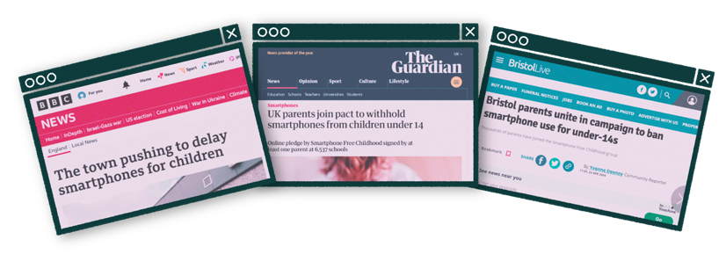
The movement is growing across the UK
140,120
Parent Pacts have been signed in 8 months
Notes:
Over 60k parents signed the pact in the first three weeks after it launched – at least one Pact has been signed at 29% of schools across the UK already! We aim to double this number over the next six months.

Slide 34

It’s happening in Derbyshire
1,933
257
Parent Pacts have been signed in Derbyshire
Schools covered in Derbyshire
Notes:
8 already signed up even before we wrote to parents

Slide 35


We’re all trying to do the best for our kids
Notes:
It’s important to say here that we know that parenting is a really difficult job, and wherever you sit on this issue we know we’re all trying to do the best we can for our children

Slide 36

We’re in this together
Navigating the fast changing world of smartphones
and social media is complex.
This stuff’s tricky, the evidence is evolving fast,
and every family is different.
Wherever you sit on the spectrum, or whatever decisions you’ve made for your children, we respect your position.
Every family will come to their own conclusions; we just want to open up a conversation about these issues.
It’s a new frontier of parenting, and we’re all in it together.
Notes:
Whatever approach you decide to take for your family, we respect your decision – every family and every child is different. And there will of course be exceptions for specific medical reasons or children with special educational needs. What we do think is important is that we’re able to discuss this issue without shame or judgement, because this is a new frontier in parenting, and we’re all in it together.

Slide 37

Let’s keep talking
Notes:
So let’s keep talking – feel free to get in touch with the school.

Slide 38




www.smartphonefreechildhood.org
@smartphonefreechildhood
Smartphone Free Childhood is a restricted fund under the auspices of Prism the Gift Fund, Charity Number 1099682.
Notes:
There are some great resources and information on the SFC website and Instagram page for anyone who’d like to find out more about the movement

